Slide 1
Asset, Product & Observable
Refactoring Proposal - Examples
Version 2.0 – 9 Feb 2024

Slide 2
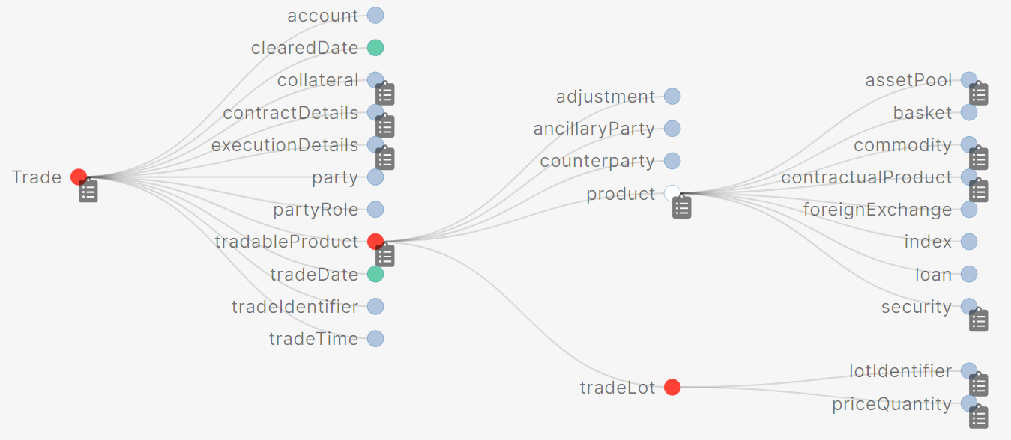
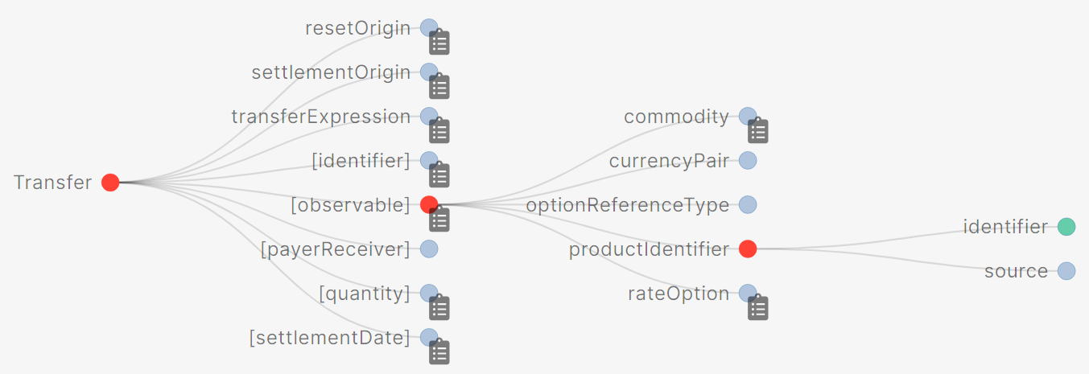
Current Model (ie CDM 5.x)
Trade is negotiated between two parties who create a TradableProduct which consists of a certain amount (TradeLot) of something (Product).
Product is a combination of different types of cash, OTC, listed and commodity products.
Transfer reassigns an Observable between two parties.
Observation records a value for an Observable seen at an InformationSource at a date and time

Slide 3
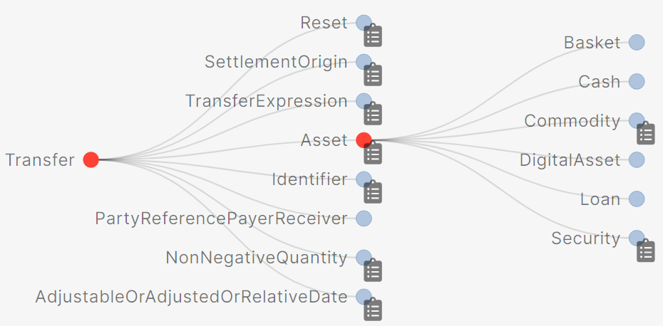
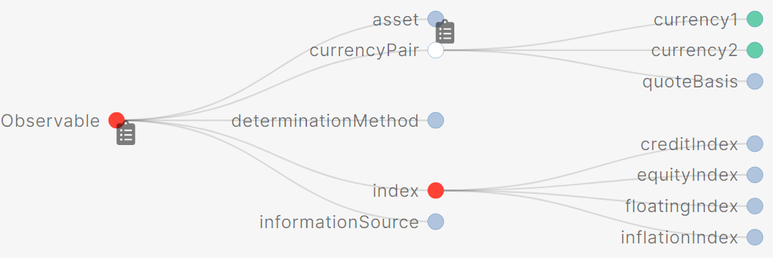
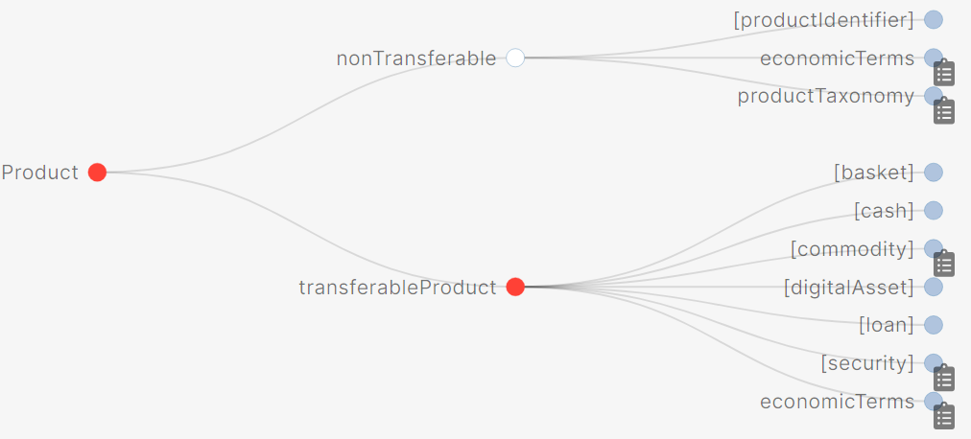
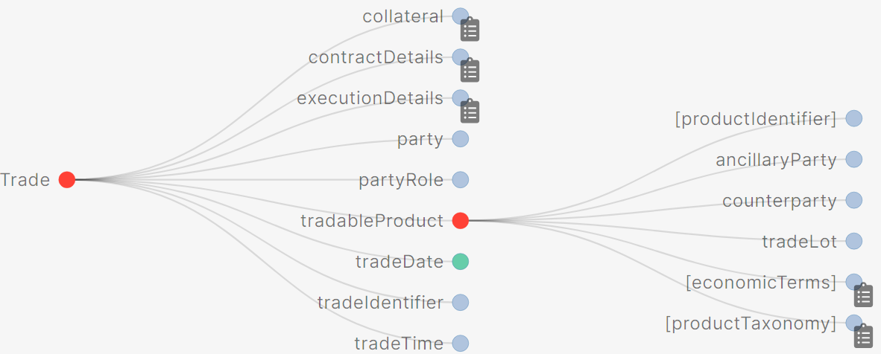
Summary of Proposed Refactoring to the Model (target CDM 6.x)
An Asset is something that can be Transferred.
The components of Asset have been defined accordingly as only those that can be held or transferred.
Asset is a root data type.
An Observable tracks the price of things in the market, including Assets.
CurrencyPair and Index are added as other market prices which can be tracked.
DeterminationMethod and InformationSource moved from ObservationIdentifier to Observable.
Products do not have public observations but could have “valuations”.
A Product is created by:
Negotiating the terms to create a NonTransferable-Product.
or
Adding EconomicTerms to an Asset to create a TransferableProduct.
and
Optionally, adding legal terms by extending Product to create a ContractProduct.
During the negotiation to create a Trade, the TradableProduct captures the EconomicTerms, Counterparty and TradeLot information.
TradableProduct extends NonTransferableProduct.

Slide 4
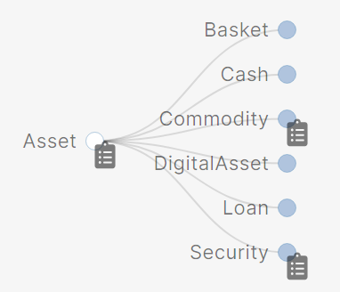
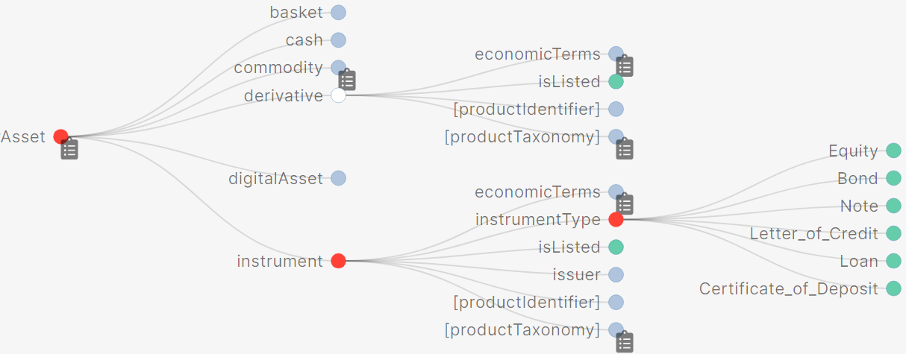
One Step Further? Refining Assets with the concept of “issuer”
Proposed model for Asset
Something that can be Transferred.
A Root data type
The proposed model for Asset keeps most of the existing attributes.
This means that it replicates some of the existing issues, that is:
Security which is more of a regulatory concept (ie SEC v CFTC) than an organised, composable modelling of financial products.
Confusion around the different methods to subdivide assets, eg through Data Types, Enums and Product Qualification (plus further methods in DRR).
Given the impact of the changes that are already proposed, is now the right time to also clean up this remaining anomaly and create a more appropriate asset model?
Additional Proposal
Replace Loan and Security with
Instrument which represents an Asset that is issued by an issuer.
Derivative which can be listed (and in practical terms, if transferable, will always be so).
A new, clean Enum hierarchy can differentiate sub-types.
Implementation details – and naming of types/attributes – for discussion.
The remainder of this deck does NOT include this further refinement.

Slide 5
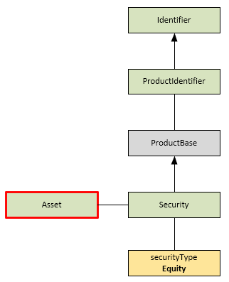
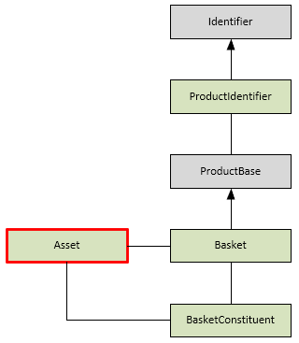
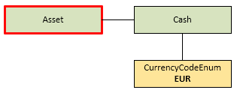
Target Model: Composition of Assets
Cash
Security
Basket
A simple basket, ie a collection of assets.
Each member of the basket can optionally have a weighting.
A basket has an identifier.
The simplist asset: “cash”.
Currency is the only attribute; there is no type or identifier.
The asset only represents the “what”, not the quantity or value..
A simple listed equity, ie a corporate stock.
Very lightweight type with just type and identification information.
type Cash:
currency CurrencyCodeEnum (1..1)
type Basket extends ProductBase:
basketConstituent BasketConstituent (1..*)
type BasketConstituent:
asset Asset (1..1)
weight number (0..1)
type Security extends ProductBase:
securityType SecurityTypeEnum (1..1)
. . .
“asset": {
“cash": {
“CurrencyCodeEnum": “EUR"
} }
“asset": {
"security": {
"productIdentifier": [ {
"value": {
"identifier": {
"value": "AAPL" },
"source": "BBGTICKER" }
} ],
"securityType": "EQUITY"
} }
"basketConstituent": [ {
"security": {
"productIdentifier": [ {
"value": { "identifier": { "value": "BOOK" },
"source": "BBGTICKER" } } ],
"securityType": "EQUITY" } } ],
“weight": {
"value": 100 }
} } ] } }

Slide 6
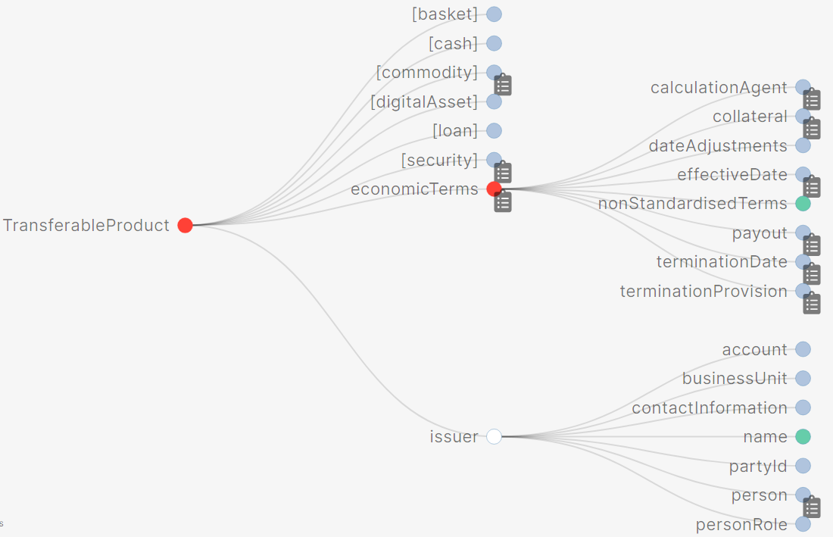
Transferable Product
Target Structure
type TransferableProduct extends Asset:
economicTerms EconomicTerms (1..1)
issuer Party (1..1)
TransferableProduct is a way to add EconomicTerms to a vanilla Asset in order to represent the underlying details of the asset.
Attributes:
ProductIdentifier (inherited from Asset)
EconomicTerms
“Issuer” – eg the Issuer of a Bond or Stock, the Borrower of a Loan, the Exchange for an ETD; this should be added so that the “direction” of the product is defined. Name subject to agreement.
Example use cases:
Bonds & Loans (in order to represent details)
Exchange Traded Derivatives

Slide 7
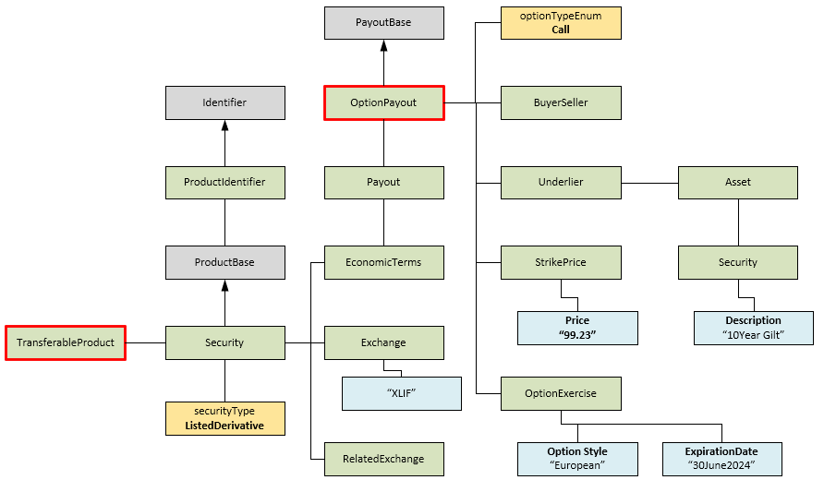
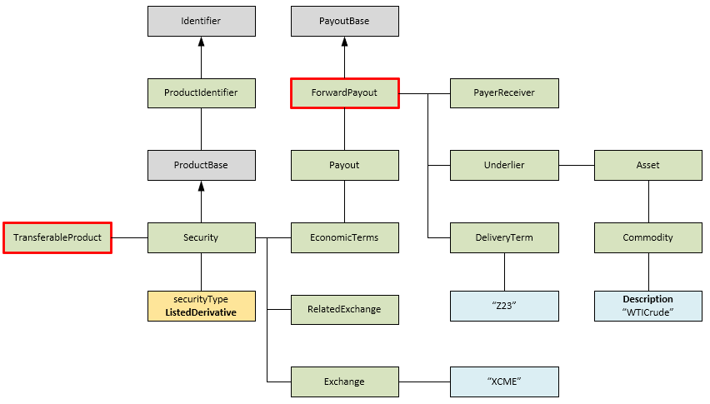
Exchange Traded Products examples
Exchange Traded Products
Represented as a TransferableProduct (ie a Security with EconomicTerms).
There is no change to the fundamental structure.
As listed products, members have requested that two additional attributes are added to Security: Exchange and RelatedExchange.
A condition should enforce that Exchange is populated if the SecurityType is “Listed Derivative”
ETD – Commodity Future
There is one ForwardPayout which specifies the underlying Asset and the delivery terms.
ETD – Bond Option
There is one OptionPayout which specifies the underlying Asset and the exercise terms

Slide 8
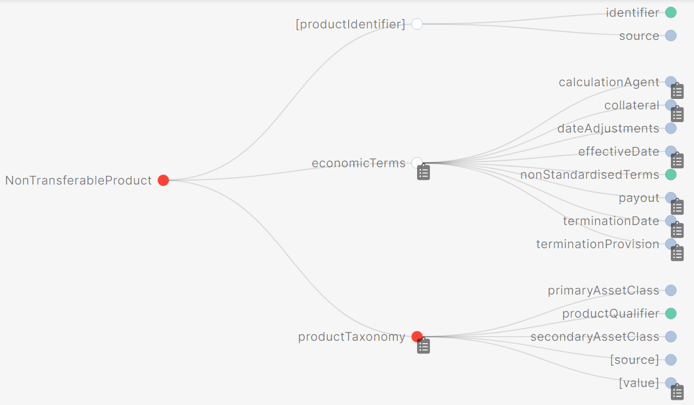
Non Transferable Product
Target Structure
type NonTransferableProduct extends ProductBase:
productTaxonomy ProductTaxonomy (0..*)
economicTerms EconomicTerms (1..1)
type ProductBase:
productIdentifier ProductIdentifier (0..*)
NonTransferableProduct is the core product offering in the CDM and is used to model the terms of a negotiated trade between two parties
Attributes:
ProductIdentifier (inherited from ProductBase)
ProductTaxonomy
EconomicTerms
Example use cases:
Trading transferable cash products (securities, loans, ETDs)
OTC Derivatives: Swaps, Swaptions, etc
Repos
Security Lending.

Slide 9
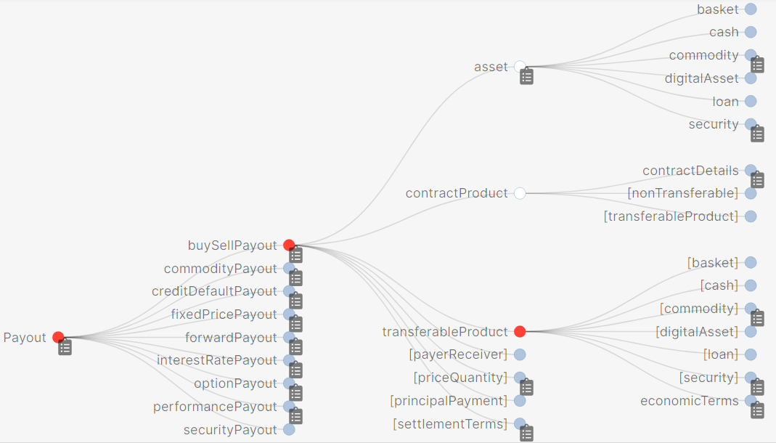
New simple Payout: buySellPayout
Proposing the creation of a new Payout type to model the straight exchange of two Assets between the two parties to the trade.
Working name buySellPayout; open to suggestions on improving the name.
This is a negotiated trade that creates a NonTransferableProduct (f.k.a. ContractualProduct).
*
type BuySellPayout extends PayoutBase:
asset Asset (0..1)
transferableProduct TransferableProduct (0..1)
contractProduct ContractProduct (0..1)
condition OnlyOne:
one-of
Updated TradeLot / PriceQuantity structure
New buySellPayout structure
* There is a known issue with the namespace hierarchy here for which we will propose a solution.
Use case in FX where the exchange of two currencies can be represented as a buySellPayout with
one party selling/paying (“payer” : “Party1”) the trade price and quantity in a given currency (in the TradeLot)
the other party buying/receiving (“receiver” : “Party2”) a given quantity of a cash Asset with a given currency in the BuySellPayout.

Slide 10
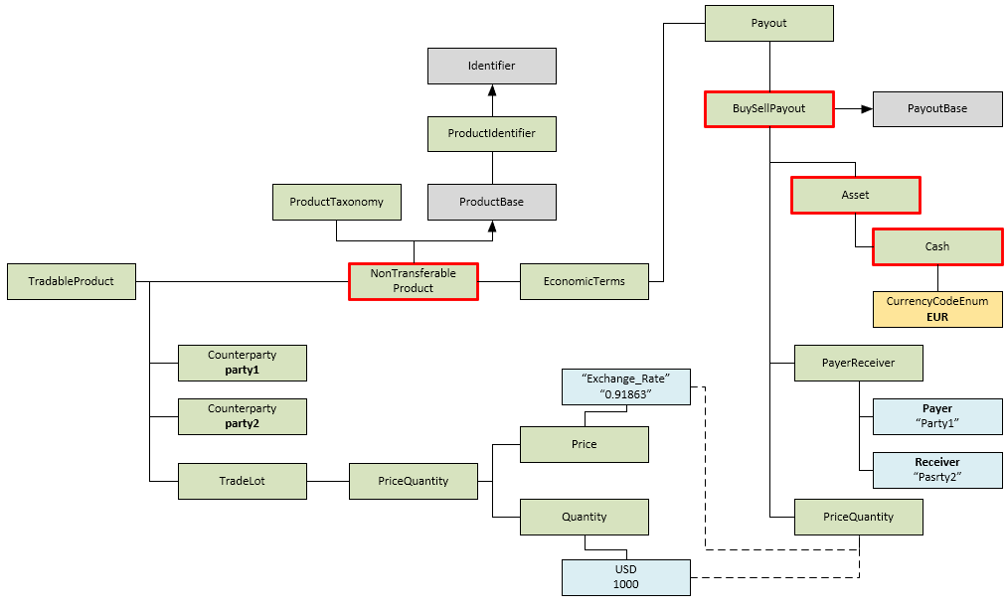
Foreign Exchange example
Example: Party1 pays $1,000 and receives €918 from Party2 .
Modeling
Trade is negotiated between two parties as a NonTransferableProduct with EconomicTerms.
Single simple payout: BuySellPayout.
TradeLot PriceQuantity describes the deal terms, ie a exchange rate price and an amount to be paid by Party1.
Asset legs specifies WHAT is paid out, ie EUR-denominated Cash by Party2.

Slide 11
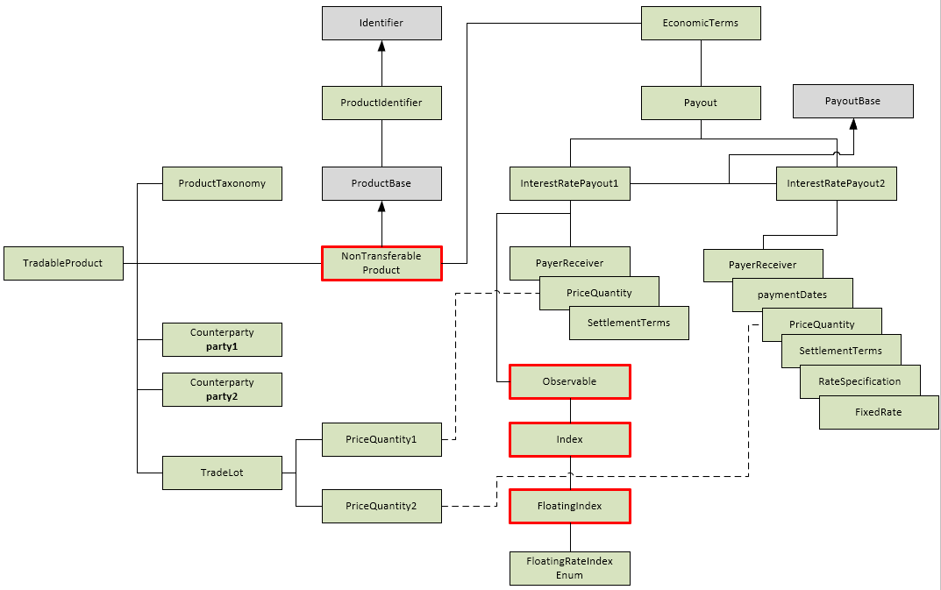
Interest Rate Swap
Changes
Product > NonTransferableProduct rather than ContractualProduct
InterestRatePayout uses an Observable to define the floating leg

Slide 12
ContractProduct
Target Structure
type ContractProduct extends Product:
contractDetails ContractDetails (1..1)
type ContractDetails: <"Defines specific attributes that relate to contractual details of trades.">
[metadata key]
documentation LegalAgreement (0..*)
governingLaw GoverningLawEnum (0..1)
[metadata scheme]
condition ExecutedAgreement: <"Contract details can only only point to executed legal agreements.">
if documentation exists
then documentation -> agreementDate exists
ContractProduct is used when additional legal terms in a formal legal agreement need to be added to a specific trade.
ContractProduct extends Product and adds the ContractDetails attribute which references a specific and executed LegalAgreement.
Example use cases:
Repo: a NonTransferableProduct with ContractDetails to make a ContractProduct
Structured Note: a TransferableProduct with ContractDetails to make a ContractProduct.

Slide 13
Observable and Observation
Target Structure
Observable retains current meaning: it relates to things that can be seen in the marketplace.
Observable has been refactored to align with Asset but also includes two items that are neither Assets nor Products:
Index – eg an interest rate, inflation or equity index.
QuotedCurrencyPair – a pair of currencies codes.
An Observation is a particular sighting of an Observable and captures the price of it at that time.
InformationSource and DeterminationMethodology have been updated to be attributes of Observable.
This enables the source of an Observable to be defined when used in a Payout; ie these conditions would be separate Observables:
EUR/USD FX as quoted by Reuters
EUR/USD FX end of day rate as published by a custodian.

Slide 14
Next Steps
Proposed Plan
Seek verbal agreement from Maintainers to proceed with the refactoring – end of February
Prepare a formal proposal – target end of March
Deck including clear definition of scope
List of proposed changes
Impact assessment
Development plan
Test plan
Communication plan
Make code changes in Rosetta – by end of May
Test & review cycle – June
Ready for Release in CDM 6.0 – July

