Slide 1
GNPY Advanced EDFA Model dtg interpretation? C. Kelly
March 29 2021

Slide 2
dgt
The GNPY advanced EDFA model includes the possibility of defining a dgt vector, which is used to derive additional gain ripple as a function of gain tilt
It appears that the example .dgt vector, from the Juniper std_medium_gain_advanced_config.json, has the frequency axis “reversed”; the shape of this vector (with the average gain slope removed) matches the expected shape from ideal amplifier simulations, except for this reversal
Suspect this came from a wavelength vs frequency description of the gain ripple vs tilt model?
The reference paper for dgt also suggests the dgt vector is reversed
As alluded to by @ojnas, the target gain tilt should be modified to include unwanted gain tilt when operating in the extended gain regime
Question: As the amplifier GFF can be designed for minimum ripple around a target tilt, which may not be zero, the gain ripple = function (tilt-”flatgain tilt”). Is this considered anywhere in derivation of the target tilt?

Slide 3
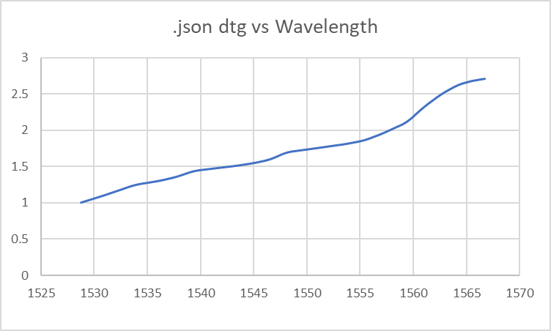
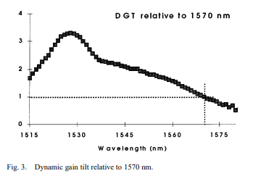
Example .dtg vector vs reference:
Muro, “The Er3+ -Fiber Gain Coefficient Derived from a Dynamic Gain Tilt Technique”, JLT Vol 18 March 2000
fmin: 191.35 fmax: 196.1 .dgt entries follow this ordering
Suggested shape from the reference paper.

Slide 4
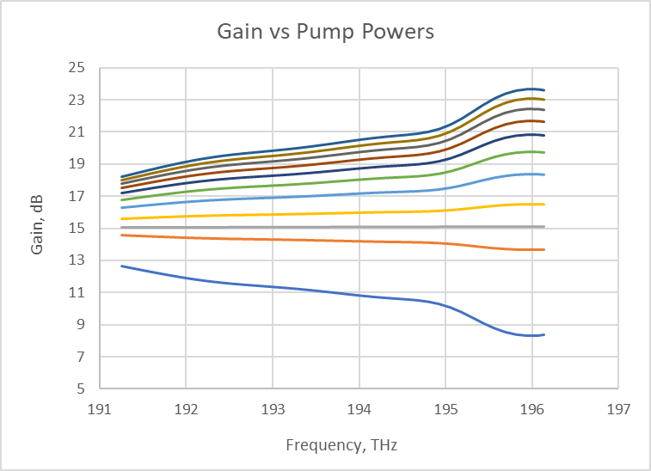
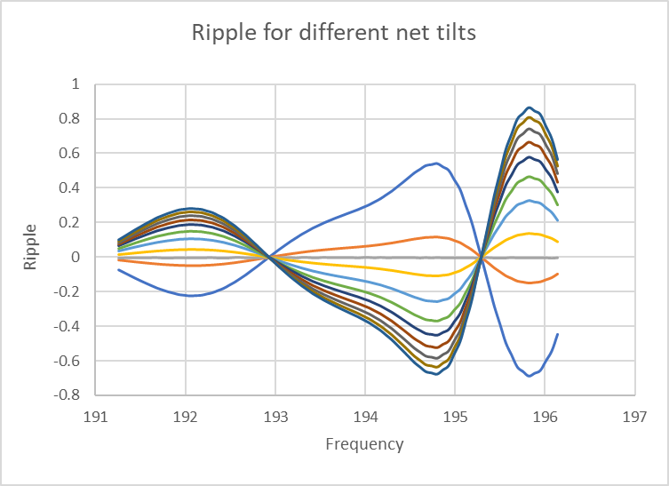
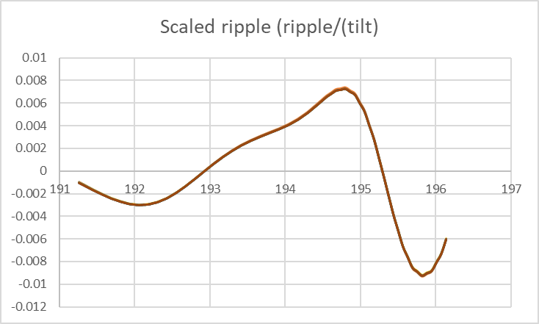
Independent Derivation using OASiX (formerly from Lucent, now OFS)
Simple fixed gain EDFA, MP980 fiber, with a gain flattening filter added, to target a flat gain at a target gain of ~15 dB
Tilt: defined with regard to wavelength, not frequency. (GNPY may use the opposite?)
-ve tilt
+ve tilt
For a constant WDM spectrum, pump power changed from the flat gain value, resulting in a change in average gainand gain tilt
Resulting gain ripple around the linear slope
Scaled ripple = ripple / (tilt x gain)
(in this example, flat gain tilt = 0)

Slide 5
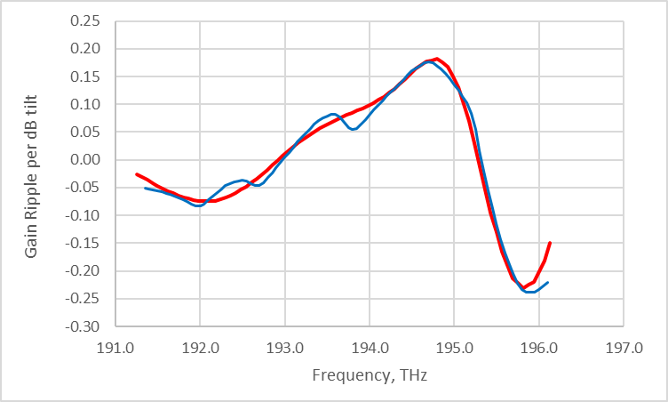
json. dgt vs. OASIX comparison
.json frequency axis reversed (196.1 to 191.35 instead)
Average slope removed from the dgt values, to estimate the gain ripple per dB of tilt around the mean gain
OASIX scaled ripple multipled by 25, reflecting the gain_maxflat value for this amplifier (from eqpt.config.json file)
Resulting .dgt derived gain ripple (per dB of tilt) matches OASiX simulations, when the dgt frequency vector is reversed.
This is the gain ripple around a linear tilt’, where the linear tilt’ = (Tilt – flat gain tilt), and Tilt = min( target tilt, actual tilt) to account for operation in the extended gain regime. (This equation depends on the tilt sign convention used by GNPY)

Slide 6
Questions/Issues:
Confirmation about the .dgt vector mis-ordering in the example EDFA .json files
Question about if GNPY’s “target tilt” includes
Concept about a “flat gain” tilt that may not be zero
Correct tilt value to be used if operating in the extended gain regime
Convention about the tilt sign (is this defined somewhere?)
Rationalle behind some of the code complexity?

