Slide 1
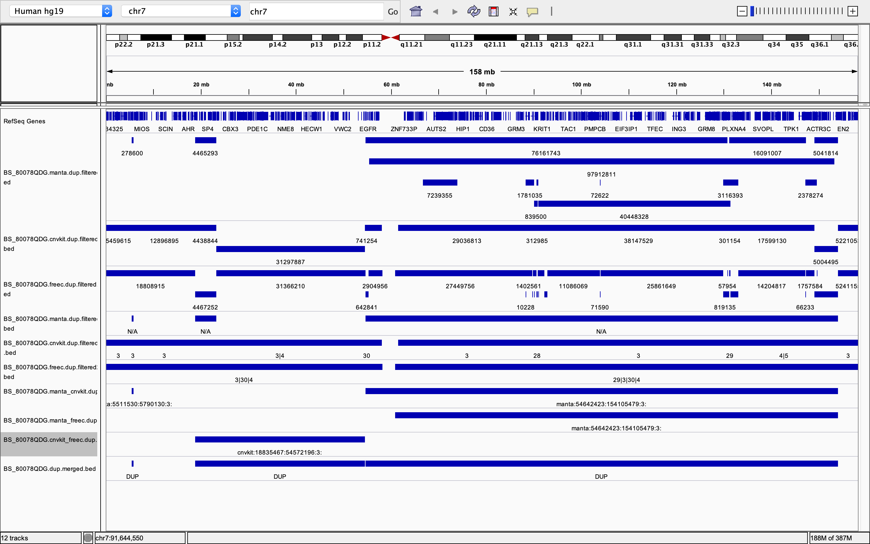
Raw files – BS_80078QDG
Due to the overlapping within one single method. Each of these method will go through an initial merging (bedtools)

Slide 2
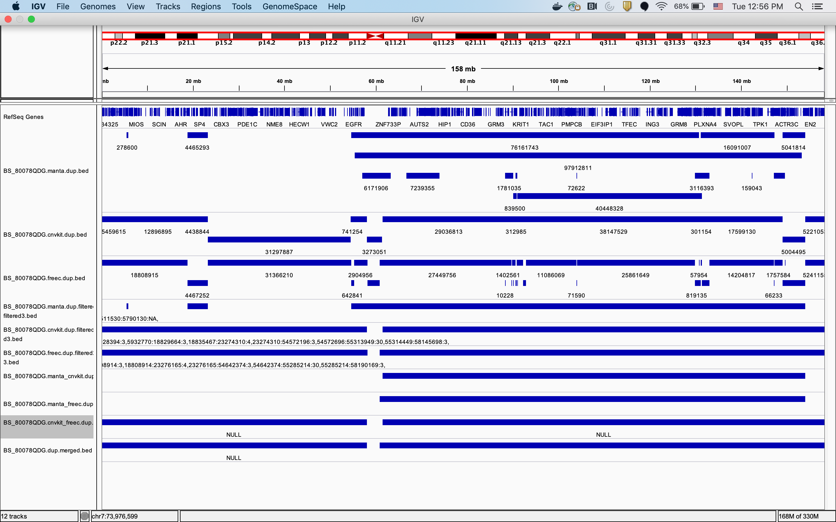
Initial Merge – Get rid of overlapping
2x2 Comparison
Merged files
Notes:
1st red box shows the 3 detection methods after merging within themselves.
2nd red box shows the result after the 2x2 comparison ( manta vs cnvkit, manta vs freec, cnvkit vs freec)
3rd red box shows the result after merging the results of the 2x2 comparisons.

